Slide 1
SUSE Studio:
Building distributions
By Cool Person
From openSUSE
Notes:
Community-focused intro:
Linux distributions often offer Live CD's or test images for users to play with. A variety of distributions even ONLY focus on creating a specific LiveCD for system rescue, partitioning or an ultra light and fast OS. Of course you can build your own Live CD – but that is a LOT of work... You usually have to install a distribution in a separate partition, modify it and then run a series of scripts (with often complicated variables you have to set) to turn it into the bootable image you wanted.
More corporate introduction:
Many ISVs grapple daily with a long laundry list of details that need to be tweaked to make an application stack work just right – and typically all that legwork has to be repeated, one customer at a time! For each platform, both in terms of hard- and software, applications have to be tested, verified and optimized. Then installed, managed, updated, upgraded...
There is a solution. Appliances package applications in an easier to consume model. As a preconfigured, ready to run image that combines the operating system and application in a single pre installed file – appliances greatly reduce the complexity of installing enterprise software.
But you have to build them yourself – not exactly easy... And updating & upgrading of appliances ain't a piece of cake either.

Slide 2
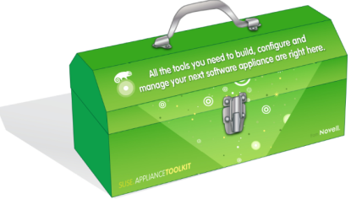


SUSE Studio – easy building of distro's
Offers an easy to use web interface where you can point and click together a linux distribution!
Easy templates to start with
Configure every aspect like installed packages, system settings and user accounts
Apply your own branding, upload custom files, boot scripts or custom software
TestRun: 45 min testing in web browser; modifications are saved in your appliance!
Integration with openSUSE infrastructure
Commercial product by Novell
Free to use on SUSEStudio.com!
Notes:
* SUSE Studio is easy peasy – and you can build a complete and powerful linux distro in there which you get, at the end of the process, as virtual image (KVM, VMware, even Amazon EC2) or LiveCD/USB including (if you want) installer.
* After giving your new distro a name, you pick a base template (either SUSE Linux Enterprise or openSUSE based). Choices are things like minimal OS, only X, minimal GNOME, full KDE, File/Print server etc.
* You can, if you want, include WebYast, so you can once your appliance is running configure it from a webbrowser!
* You can make the appliance your own, adding files to the home directory of your user(s) or installing custom apps and boot up scripts.
* Once the Appliance is build you can let it boot up on the SUSE servers and test drive it for 45 minutes through a flash plugin or via remote SSH. Any changes you make are saved in the appliance!
* It is possible to add OBS repositories to SUSE Studio, or export your SUSE Studio image as KIWI config script so you can control the whole live image creation from the commandline!
* SUSE Studio can be bought from Novell so a company can use it in-house to develop their own images; to provide their customers with updates (yes, SUSE Studio images can be updated!) etcetera
* However anyone can play with it free on SUSEStudio.com and publish the results in SUSEGallery.com!

Slide 3
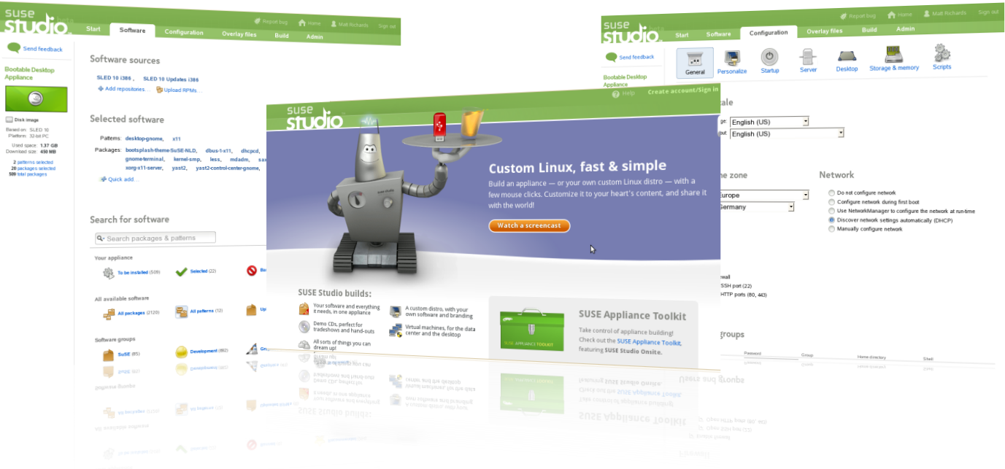
Notes:
Here you see SUSE Studio – in the center the start page, left the configuration of software and right the configuration of users and other basic settings. Remember however that everything is fully configurable in SUSE Studio, even though it is very easy to use!

